Slide 1
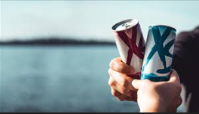

Prepared by:
Hari Kadam
CodeX Marketing Survey Analysis
Codebasics Resume Challenge 6

Slide 2
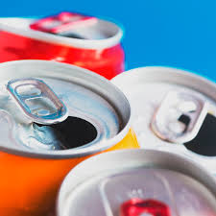
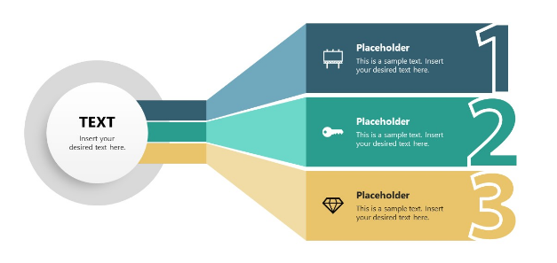
Context
Agenda
Schema
Insights

Slide 3
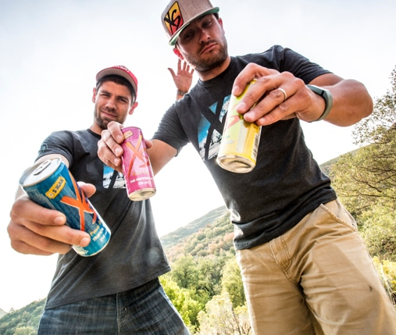
1. Context
Company Information
CodeX is a German beverage company that is aiming to make its mark in the Indian market. After completely dominating European energy drink market, CodeX is eying on Indian market which is growing since a decade.
Problem Statement
A few months ago they conducted a survey in 10 cities in order to gather insights. As a marketing data analyst is we are tasked to convert these survey results to meaningful insights which our team can use to drive actions.

Slide 4
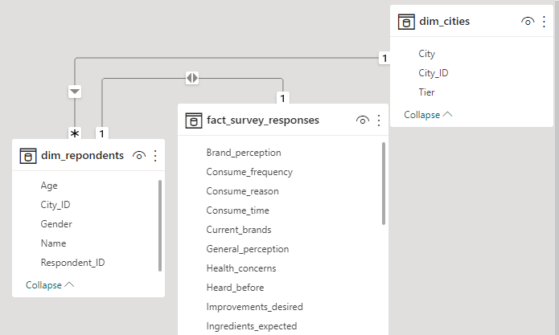
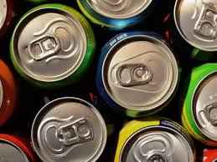
2. Schema

Slide 5
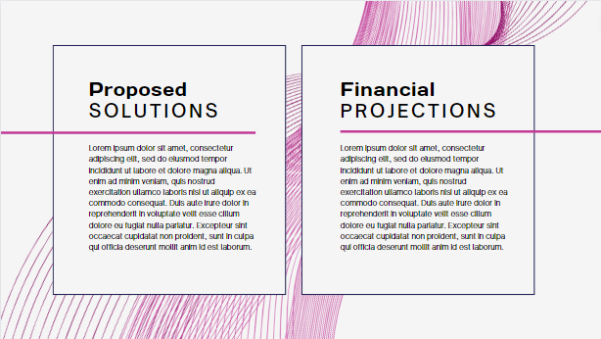

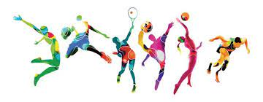
3.Insights
Secondary Insights recommendations
Primary Insights
In primary insights we will gather insights from demographics, Consumer preferences and Purchase behavior
In secondary insights we will look into immediate improvements and recommendations for our product

Slide 6
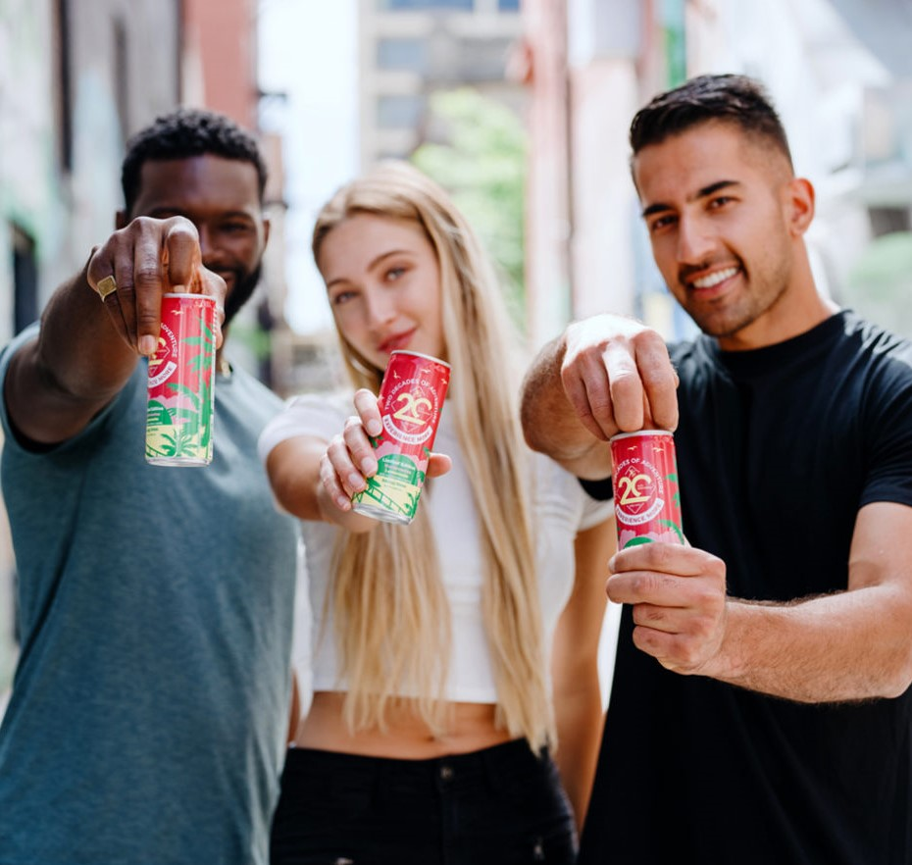
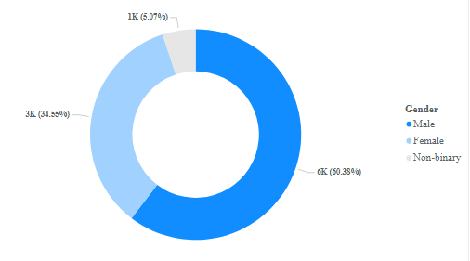
1. Demographic Insights
A. Who prefers energy drink more (Male / Female / Non binary)?
60% of the people who prefers energy drink are male, so it is obvious to align our strategy more closely with male population.

Slide 7
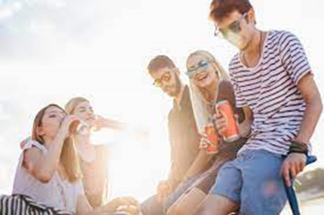
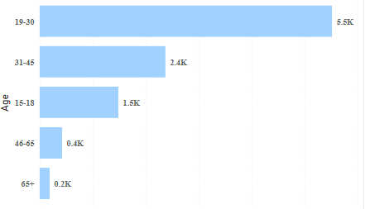
B. Which age group prefers energy drink more ?
Age group count
Almost 80% of people who prefers energy drink fall into 19 to 45 age group. This may be due to lifestyle and disposable income.

Slide 8
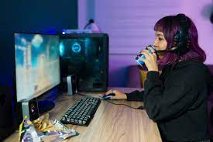
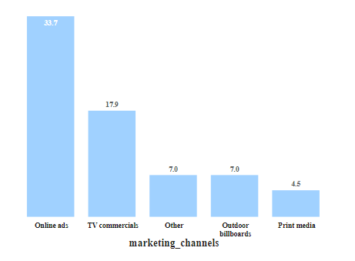
C. Which type of marketing reaches the most youth (15 - 30 ) ?
Marketing channel reach %
Online ads and TV commercials combined reach more than 50% of target audience. This may be due to online presence and lifestyle.

Slide 9
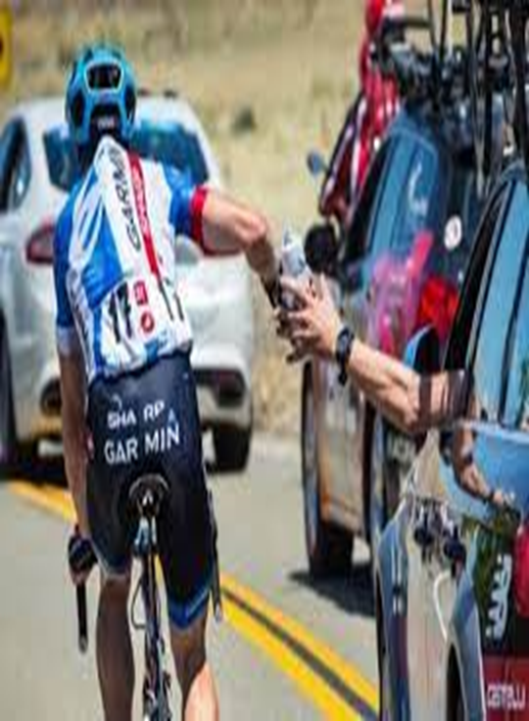
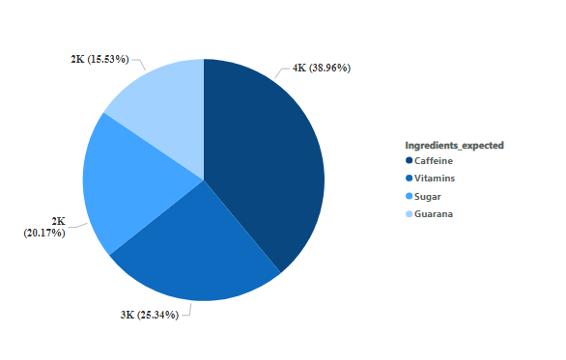
Consumer Preferences
1. What are preferred ingredients of energy drink among respondents ?
Caffeine is most loved ingredients among the respondents following Vitamins. Caffeine works as stimulant and energy booster.

Slide 10
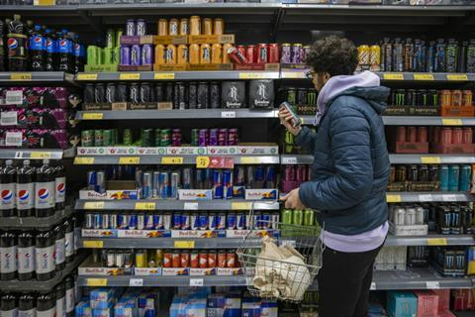
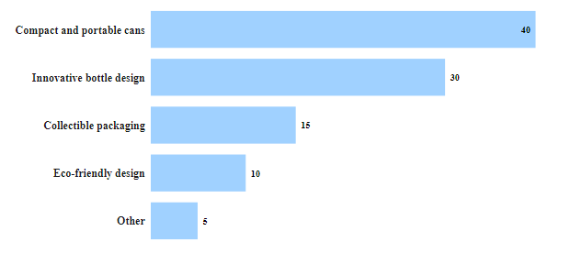
B. What packaging preferences do respondents have for energy drink ?
Packaging preferences share %
Respondents prefer Compact and portable cans and Innovative bottle designed drinks more and that numbered more than 2/3 of surveyed people.

Slide 11
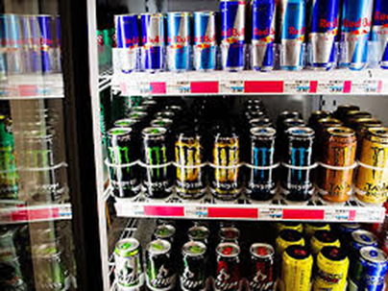
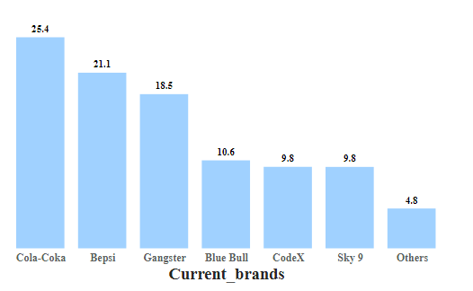
3. Competition Analysis:
A. Who are the current market leaders ?
Market share %
Cola-Coka and Bepsi have combined grabbed approximately 50% of the market share, while we CodeX at 5th place in terms of market share contribution.

Slide 12
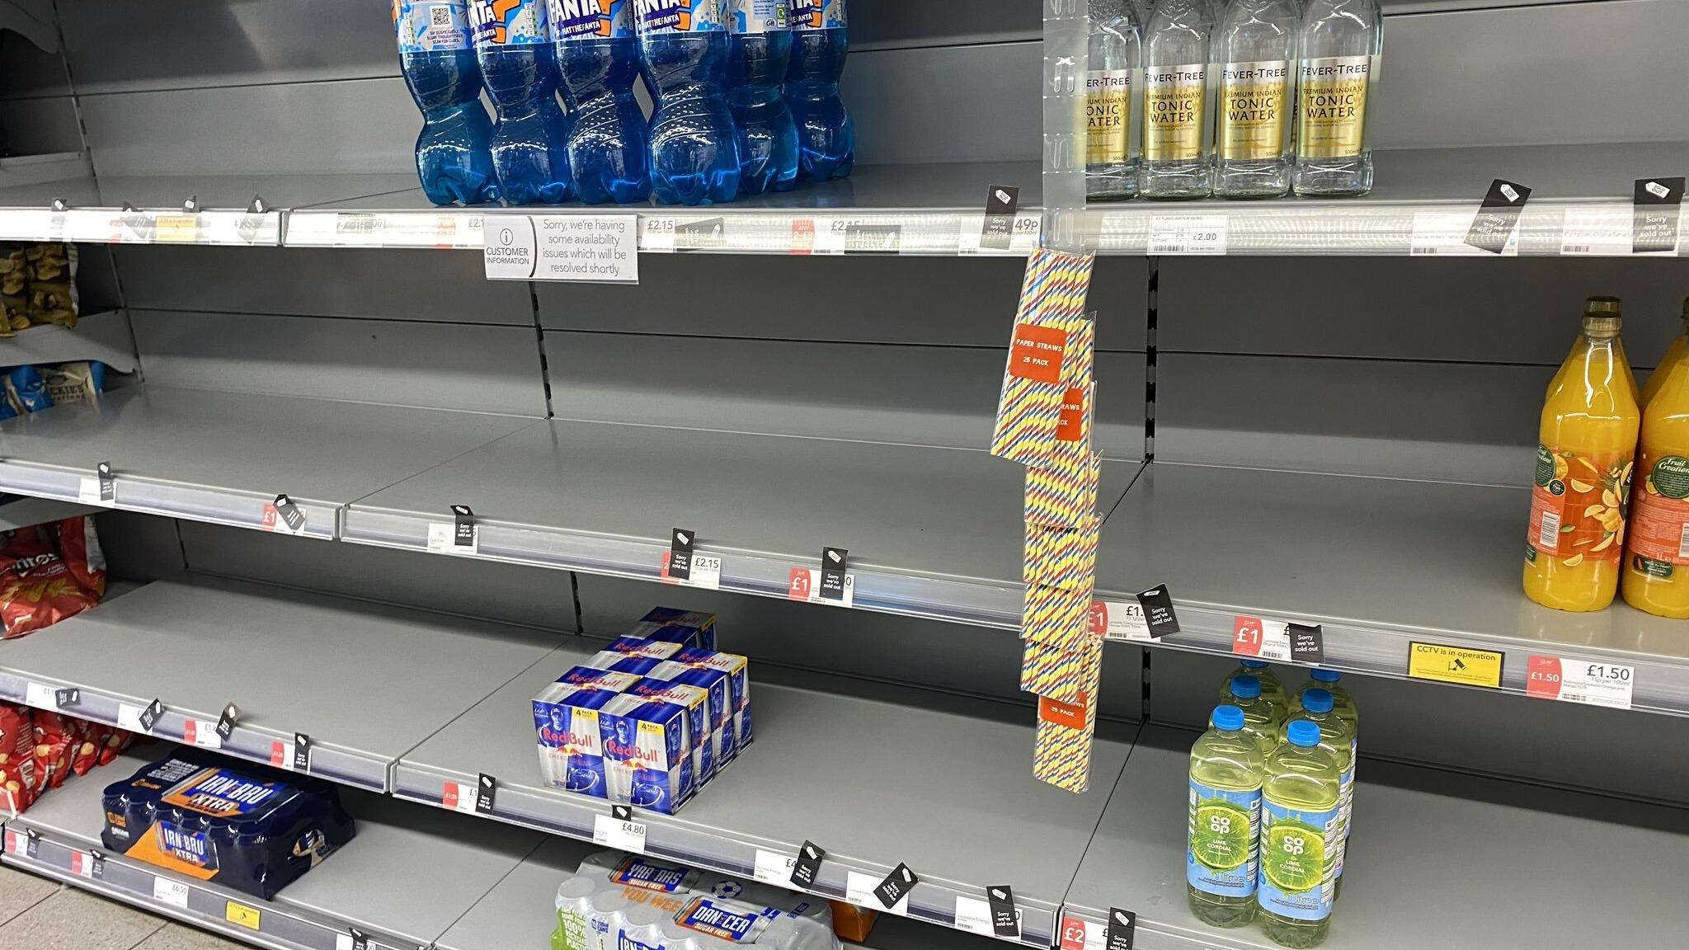
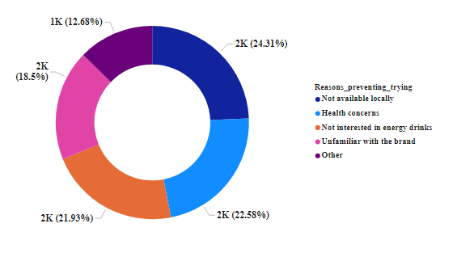
B. What are the primary reasons consumers prefer those brands over ours ?
Not availability of Codex drink at local stores and skepticism around processed drinks are leading causes of not choosing our drink. These problem's can be addressed by strengthening supply chain and educating diaspora about our drinks.

Slide 13
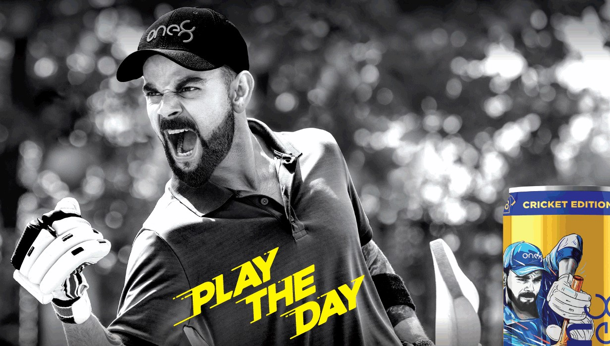
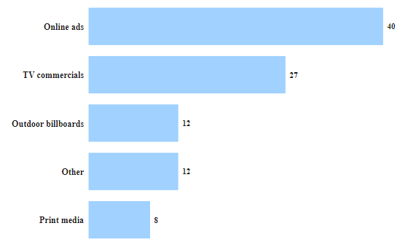
4. Marketing channels and brand awareness
A. Which marketing channel can be used to reach more customers ?
Marketing channel share %
Online ads and TV commercials completely dominating marketing channels so its crucial to double down on reaching potentials consumers through these channels.

Slide 14
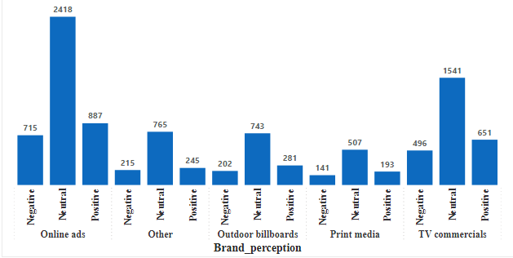
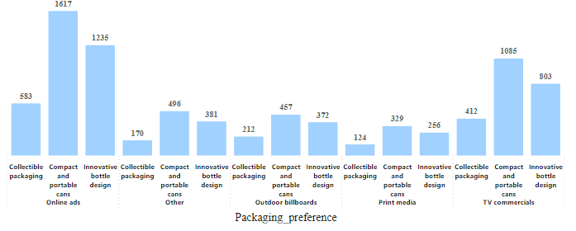
B. How effective are different marketing strategies and channels in reaching out customers?
A. Marketing channels and brand perception
B. Marketing channels and packaging preference
No marketing channel has been fruitful to improve brand perception, since respondents have neutral view in every case.
Compact and portable cans and Innovative bottle designed drinks loved by respondents marginally.

Slide 15
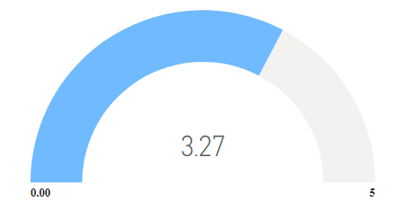
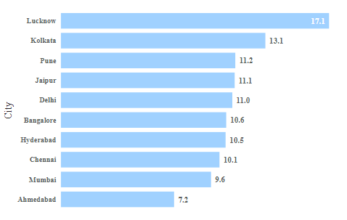
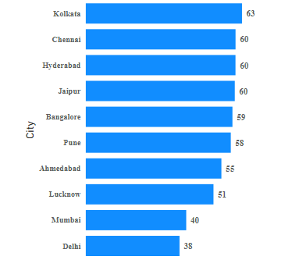
5. Brand Penetration
A. What do people think about our brand? (Over all rating)
B. Which cities do we need to focus more on ?
Not heard about Codex in %
Heard but not available locally %
Average Taste Rating
Our brand has quite bad overall rating, that indeed needs to be improved.
In cites like Kolkata, Chennai and Hyderabad people did not even hear about brand highlighting our marketing campaign failure.
We do have supply chain issues as well in Lucknow, Kolkata and Pune where drinks are not available in stores.
Respondents not heard about CodeX %
CodeX drink not available locally %

Slide 16
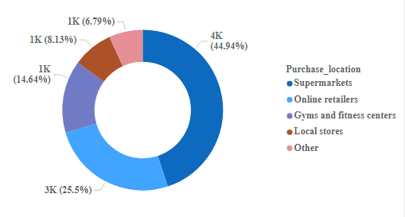
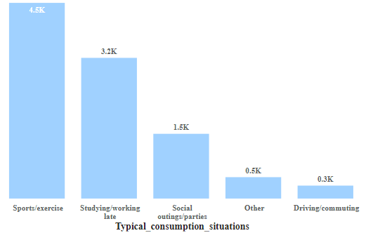
6. Purchase Behavior
A. Where do respondents prefer to purchase energy drinks ?
B. What are typical consumption situations for energy drinks among respondents ?
Consumption situation share
People prefer to purchase energy drink at supermarket (45%) following Online retailers (25%)
As energy drink is quick energy source, it is preferred at sports/exercise events and studying or late work situations comprising 75% of all.

Slide 17
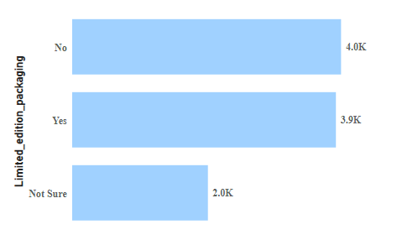
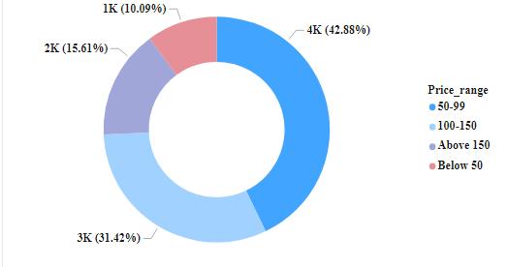
C. What factors influence respondents’ purchase decisions, such as range and limited edition packaging ?
A. Price range
B. Limited edition packaging
Preference count
Customers prefer energy drink priced between RS 50-99 (42%) most following energy drink priced at RS 100 – 150 (31%).
Limited edition packaging has not impact on respondents purchase decisions at all.

Slide 18
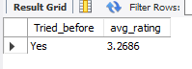
7. Which area of business should we focus more on our product development ? ( Branding / Taste / availability )
I believe we should more focus on taste and availability. As taste of our drink is mere 3.2 which has a lot of scope to improve and that can be done by fruit extracts and natural sourced sugar.
As bar chart shows availability is another concern product reach. Its predominant in Lucknow, Kolkata and Pune. It must be resolved by strengthening supply chain issues.
CodeX drink not available locally %

Slide 19
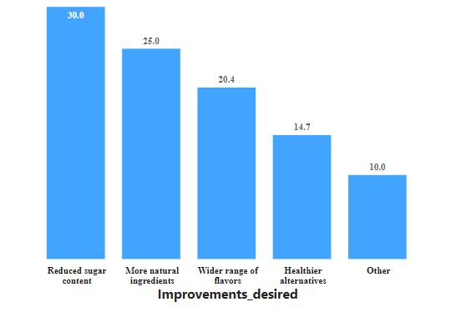
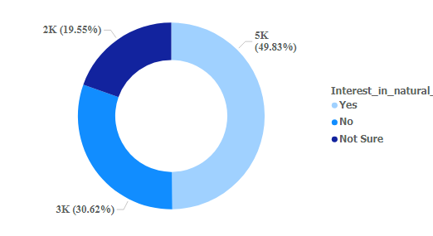
Recommendations
1. What immediate improvements can we bring to the product?
We can improve our drinks test, which is mere 3.2 with most sought after ingredients like Caffeine and Vitamins. Along with that reducing sugar content and widening range of flavors such as Guarana we will cater customers needs
Improvements desired share %
We can improve customer base significantly by choosing natural ingredients since 50 % of customers are interested in it.

Slide 20
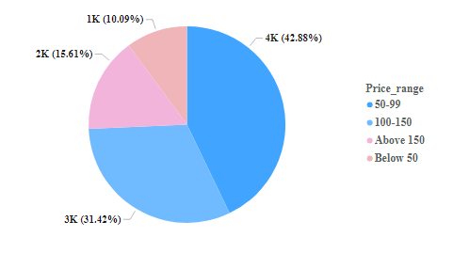
2. What should be the ideal price of our product ?
As clearly seen from the chart that customers prefer energy drink priced between 50-99 Indian rupees.
Another pricing strategy could be used by having mid range product pricing 100 – 150 which will compel customers choosing lower priced product. Ultimately that will satisfy customer thinking product being sold at cheap price and making smart move.

Slide 21
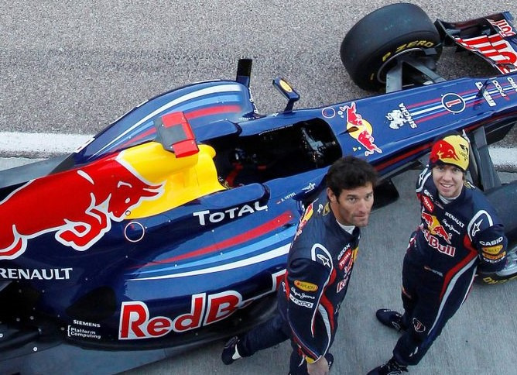
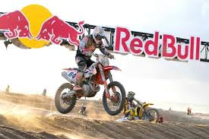
3. What kind of marketing campaigns, offers, and discounts we can run ?
As humans we associate quality of person, event with the products and services they are endorsing. The same psychological advantage is used by energy drink seller Red-Bull that controls of over 70% of the $1.6 billion US market, which sponsor sports events of mountain biking, wind surfing, snowboarding, Formula 1, music concerts and videogame events.
Red-Bull taken marketing to a new level by sponsoring Stratos Project in which Felix Baumgartner had to free fall jump from the Earth stratosphere in a helium balloon.
After this project the company increased 7% of its sales in just six months generating $1.6 billion and selling 5.2 billion cans in the following year.
Likewise we can also do branding of our product by sponsoring various best known events like Jashn-e-Rekhata, a Hindi-Urdu Kavisammelan happens every year in New Delhi, sponsoring Tech-fest events at various premier schools like IITS, IIMs and NITs and sponsoring IPL, a cricket festival for Indians, which is watched by 1.5 crore Indians on every single day for 60 days.

Slide 22
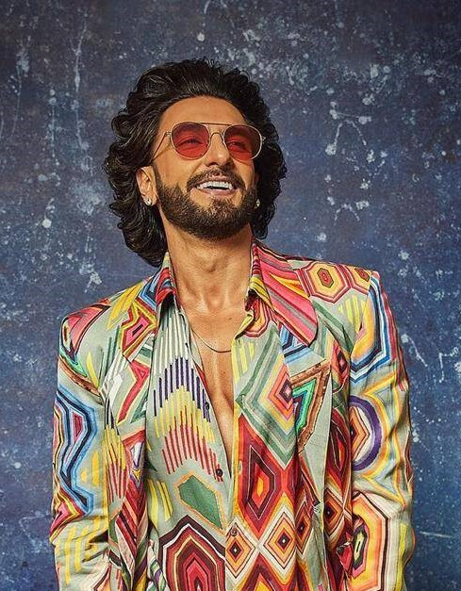
4. Who should be a brand ambassador, and why ?
The ideal brand ambassador possess qualities that align with the energy drink's target audience and brand values. Since our target audience is between 15 to 35 age group, who sees a film actor as Hero and follows their style and endorsements.
For these reason I believe Ranveer Singh will be ideal choice for our CodeX brand. He has massive fan following of 41 Million and has charismatic personality. His energy, fitness, and dedication to acting align well with the concept of energy drink.
Along with that he actively supports his wife Deepika
Padukone, who is Bollywood celebrity, a social activist and mental health supporter.

Slide 23
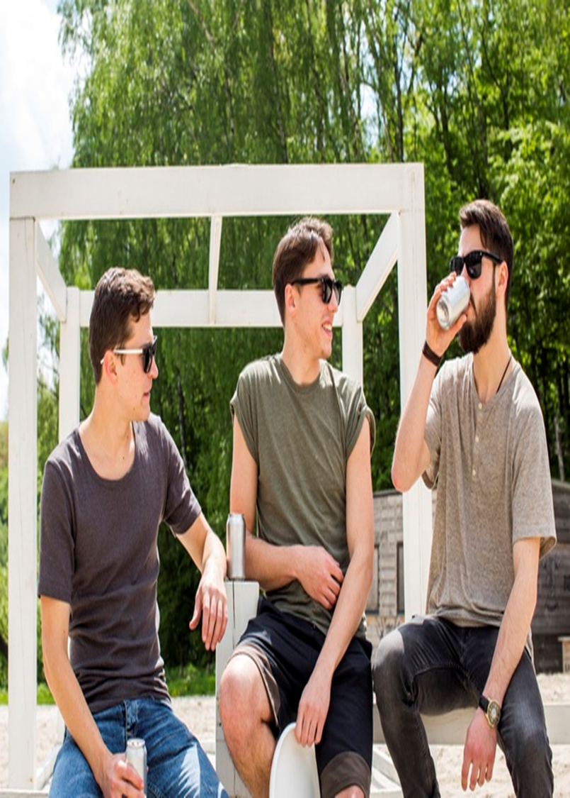
5.Who should be our target audience and why ?
India's Population dynamics according to 2021 population census
0 to 14 years: Approximately 26-28%
15 to 24 years: Approximately 17-19%
25 to 44 years: Approximately 40-42%
Which tells that our target audience should be between 15 to 44 comprising approximately 60% of the Population. With the advent of telecom and mobile revolution, its little easy to market our product through online ads, TV commercials, sports events like IPL and FIFA and online games.
Along with that they have disposable income and their needs can be catered by our energy drink as quick energy source at gym or sports events, studying and late night work and social gatherings.

Slide 24
Insights and Recommendations:
Target Audience: Our primary target audience should be individuals aged between 15 to 45 years. To effectively reach this demographic, we should utilize online ads and TV commercials, as these channels collectively reach 50% of potential customers.
Enhancing Taste: It is crucial to address the low taste rating (3.2) of our energy drink. We can achieve this by incorporating significant changes, such as adding Caffeine, Vitamins, and fruit extracts. Given that 49% of our target audience values health consciousness, using natural ingredients will be a game changer.
Importance of Packaging: The packaging of our energy drink plays a significant role in consumer preference. Nearly two-thirds of respondents prefer compact and portable cans with innovative bottle designs.
4. Addressing Concerns: The main obstacles that deter potential customers from choosing our drink are its non-availability, health concerns, and unfamiliarity with our brand.
5. Focused Marketing: To counter the lack of awareness about our drink brand, we must concentrate our marketing efforts in key cities like Kolkata, Hyderabad, Chennai, Jaipur, Bangalore, and Pune. More than 55% of survey participants in these cities reported never having heard of our drink.

Slide 25
6. Strengthening Supply Chain: It is essential to bolster our supply chain in Lucknow, Kolkata, Pune, Jaipur, and Delhi, as over 10% of customers have reported encountering unavailability of our drink in stores.
7. Purchasing Preferences: Customers predominantly rely on Supermarkets (45%) and Online stores (25%) for purchasing our drink.
8. Pricing and Packaging Impact: Respondents generally prefer buying drinks priced between Rs 50 to 99, and limited-edition packaging appears to have no significant impact on buying behavior.
9. Expanding Marketing Efforts: To widen our market reach, we should consider sponsoring and organizing quality events, similar to Red Bull's successful strategy with events like Formula 1, Mountain biking, and Snowboarding.
10. Brand Ambassador: Apart from improving taste and packaging, appointing a brand ambassador like Ranveer Singh, whose values align with our brand's vision, will further enhance our brand image.

Slide 26

Feel free to comment, share or highlight mistakes that I have done in presentation or analysis.

